Slide 1
Event Registration System
Final Year Project Presentation
Student Name: AJIBEWA DANIEL
Registration Number: 25625
Course:
Institution: ADVENTIST UNIVERSITY OF CENTRAL AFRICA
Supervisor:
Date:

Slide 2
Introduction
Events are common in universities and organizations.
Manual event registration is slow and error-prone.
This project introduces a web-based Event Registration System to automate the process.

Slide 3
Problem Statement
Manual registration causes:
- Long queues
- Data loss
- Duplicate records
- Poor attendance tracking
- No proper reporting system
- No automated confirmation to participants

Slide 4
Objectives of the Project
Main Objective:
To design and implement an automated Event Registration System.
Specific Objectives:
- To allow users to register online
- To enable admins to create and manage events
- To generate event tickets
- To track attendance digitally
- To generate event reports

Slide 5
Scope of the System
The system allows:
- User registration and login
- Viewing available events
- Online event registration
- Ticket generation
- Attendance tracking
- Admin event management
Not included:
- Online payment (future enhancement)

Slide 6
Tools & Technologies Used
Programming Language: Java (Spring Boot)
Database: MySQL
Frontend: HTML, CSS, JavaScript, Bootstrap
Version Control: Git & GitHub
Containerization: Docker
Diagram Tool: Draw.io

Slide 7
System Architecture
The system uses MVC Architecture
- Model: Database & business logic
- View: User interface
- Controller: Handles user requests
Advantages:
- Easy maintenance
- High security
- Scalable

Slide 8
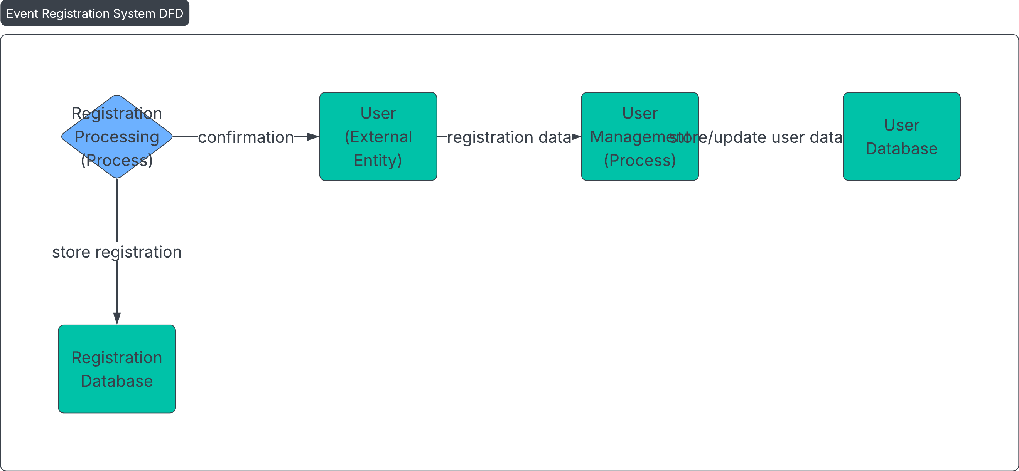
Data flowDiagram

Slide 9
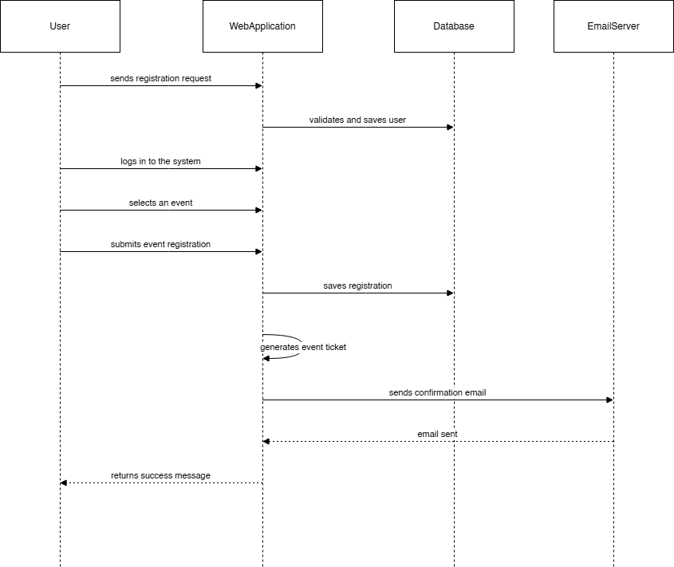
Sequence Diagram

Slide 10
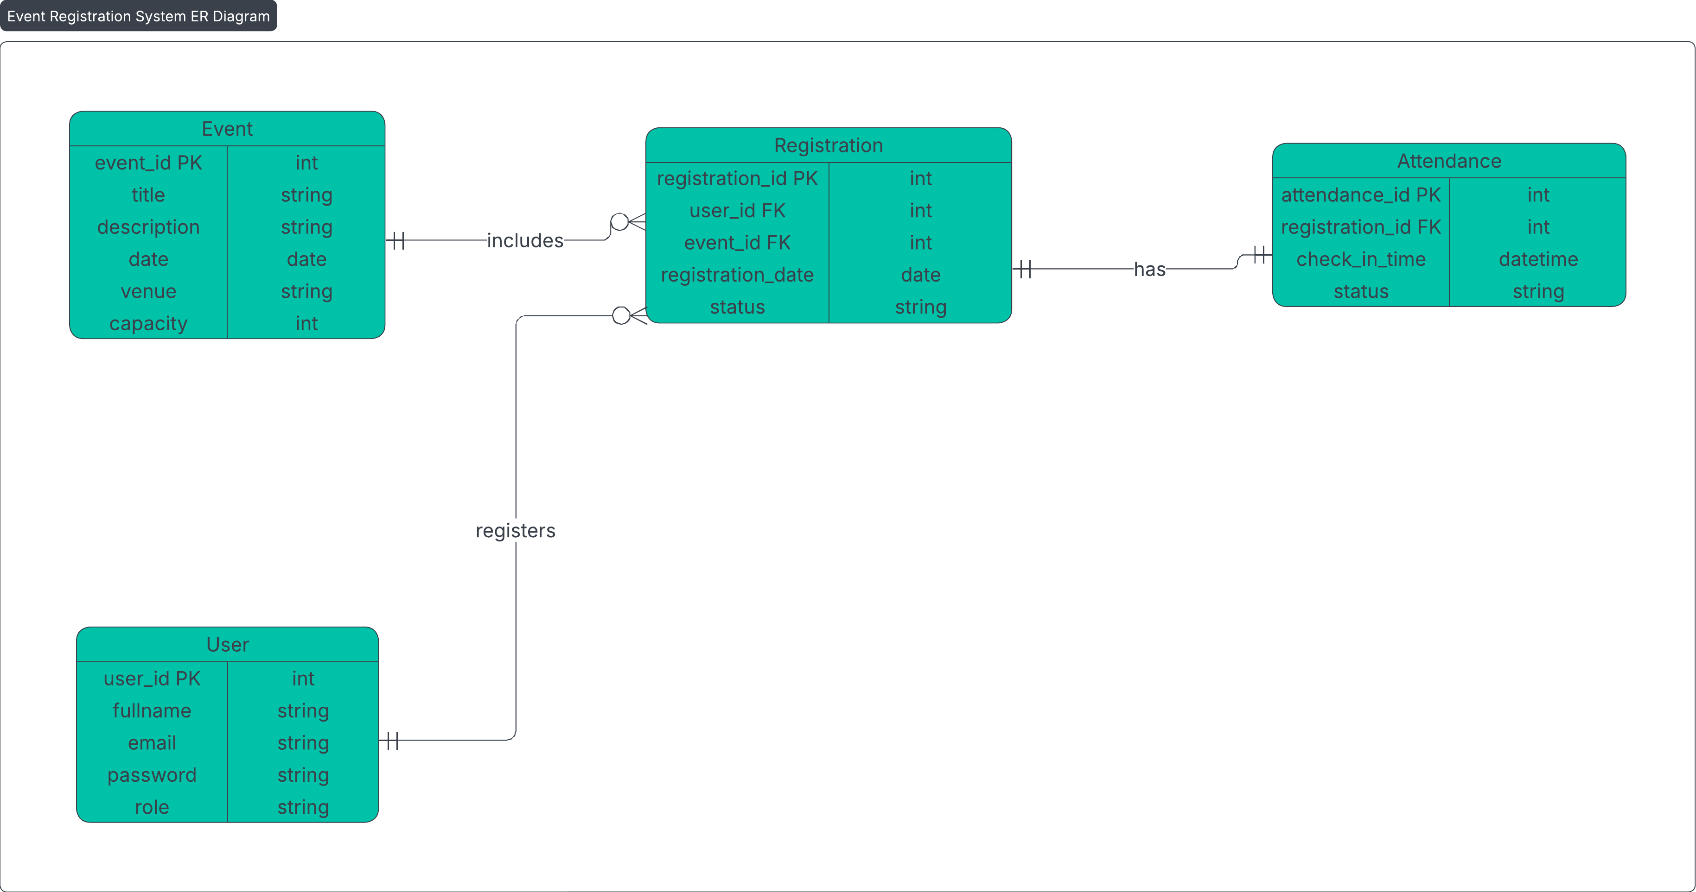
Database Design (ER Diagram)
(Insert your ER Diagram here)

Slide 11
Design Patterns Used
Singleton Pattern: Used for database connection. Ensures only one DB instance.
Factory Pattern: Used for creating user roles. Admin and User objects

Slide 12
System Features
User Registration & Login
Event Creation
Online Event Registration
Ticket Generation
Attendance Tracking
Email Notifications
Admin Dashboard
Report Generation

Slide 13
Testing Methods
Unit Testing
Integration Testing
Manual Testing
Tested modules:
- User Registration
- Login
- Event Creation
- Event Registration
- Attendance Tracking

Slide 14
Deployment (Docker & GitHub)
Docker used to containerize:
- Backend service
- MySQL database
GitHub used for:
- Version control
- Project sharing
- Code backup

Slide 15
Results
System works successfully
Users can register without errors
Admin can manage events properly
Attendance tracking is accurate
Data is stored securely in MySQL

Slide 16
Limitations
No mobile application version
No online payment integration
Requires internet connection

Slide 17
Future Enhancements
Mobile app version (Android & iOS)
Online payment integration
SMS notifications
Facial recognition attendance
Advanced analytics dashboard

Slide 18
Conclusion
The Event Registration System successfully automated:
- Event management
- Participant registration
- Attendance tracking
The system reduces manual work and improves efficiency.

Slide 19
GitHub Repository
Project Source Code:
(Paste your GitHub link here)
Open source and well documented

Slide 20
Thank You
Thank You for Listening
Questions & Answers

